Slide 1
Basic Concepts of Thermodynamics
B.Sc Chem (H) 3rd Semester
Physical Chemistry
Dr. Sayantani Chatterjee
Assistant Professor
Vijaygarh Jyotish Ray College
8,2 Jadavpur Central Rd
Bijoygarh, Jadavpur
Kolkata-700032

Slide 2
Todays learning objectives
What is Thermodynamics
Laws related to Thermodynamics
What is system and surroundings
Types of system
Types of process
Classification of functions
Statement and mathematical form of Thermodynamics 1st law
Concepts of Enthalpy

Slide 3
Thermodynamics
Thermodynamics is a branch of Physical Chemistry in which the motion of heat i.e. the change of heat of any chemical substance during any chemical or physical change is studied.
Thermodynamics monitors the effects of heat , energy and work of a system
Thermodynamics is only deals with macroscopic changes and observations.

Slide 4
Laws of Thermodynamics
Zeroth law of Thermodynamics- When two bodies are in thermal equilibrium with a third body, they are also in thermal equilibrium with each other.
First law of thermodynamics- This law is related to conservation of energy i.e. energy can neither be created nor be destroyed, it can only be transformed from one form to another.
Second law of thermodynamics- The heat taken from the source is not completely convertible to mechanical work i.e. in other words this is impossible to construct an engine with 100% efficiency.
Third law of Thermodynamics- For an isolated system e.g. for any perfect crystalline solid at zero kelvin temperature the entropy will be zero.

Slide 5
Common terms using in thermodynamics

Slide 6
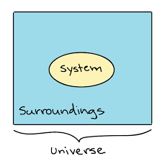
System- The part of the system which is under thermodynamic observation
Surroundings-
The remaining part other than system is called surroundings

Slide 7
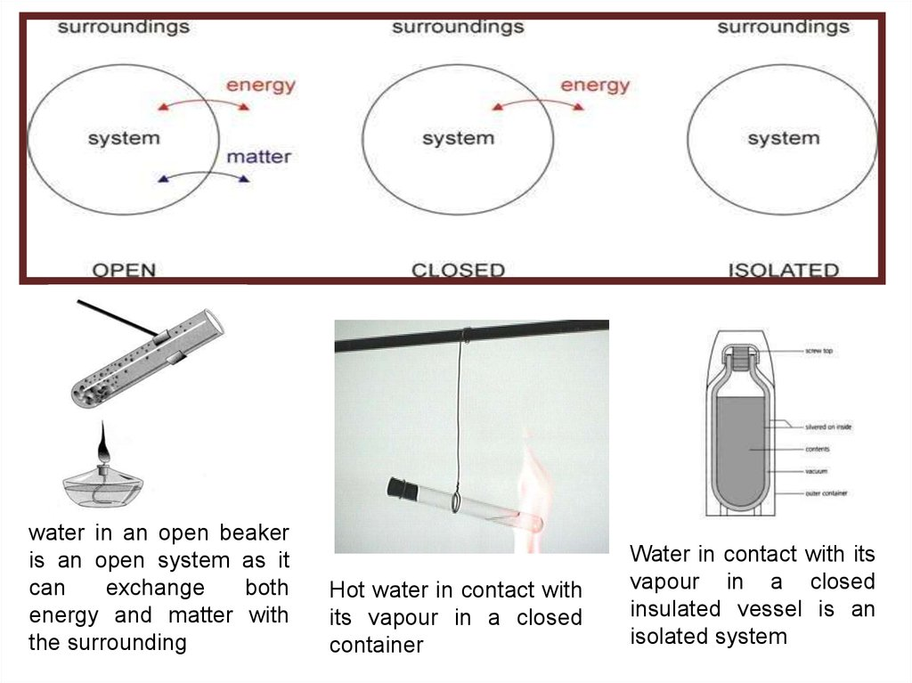

Slide 8
Thermodynamic systems

Slide 9
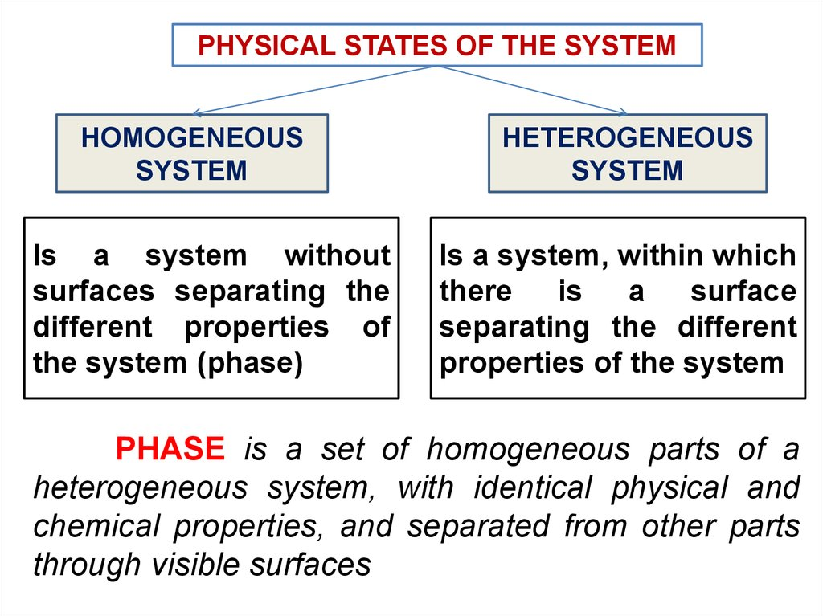

Slide 10
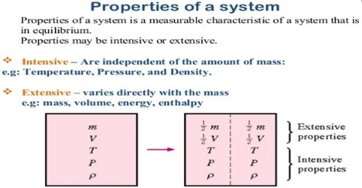

Slide 11
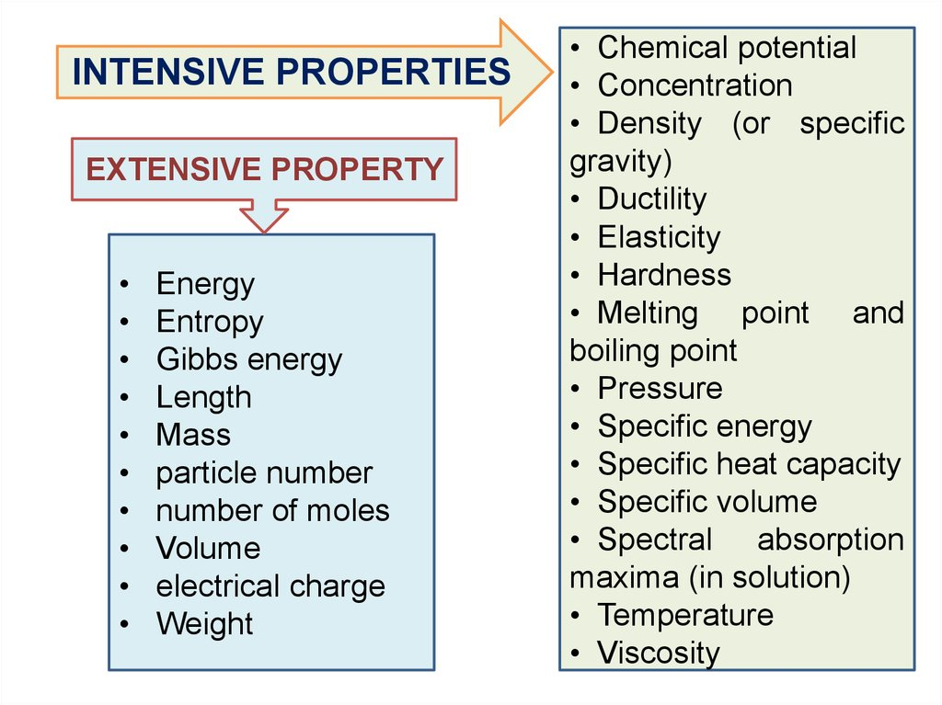

Slide 12
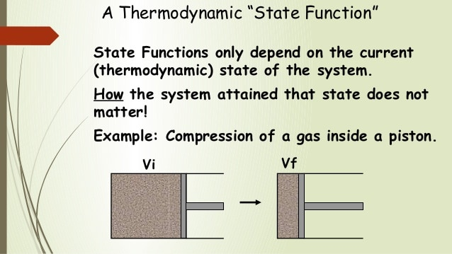

Slide 13
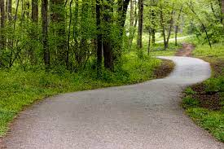
Path function
A path function does depend on the path followed in getting from the starting to the final step. They are inexact differentials.

Slide 14
Path function
Work (W) and heat (q) are path functions.
Two mountain climbers of equal mass scale the same cliff. One climbs straight up while the other backslides numerous times on the way up…
Who did more work?

Slide 15
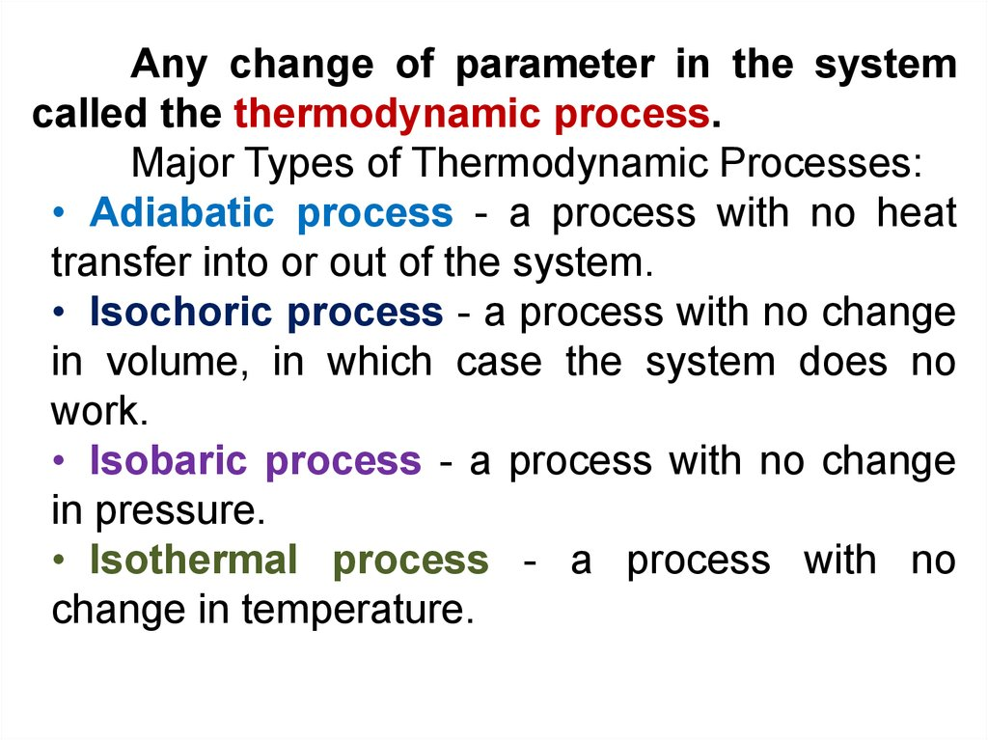

Slide 16
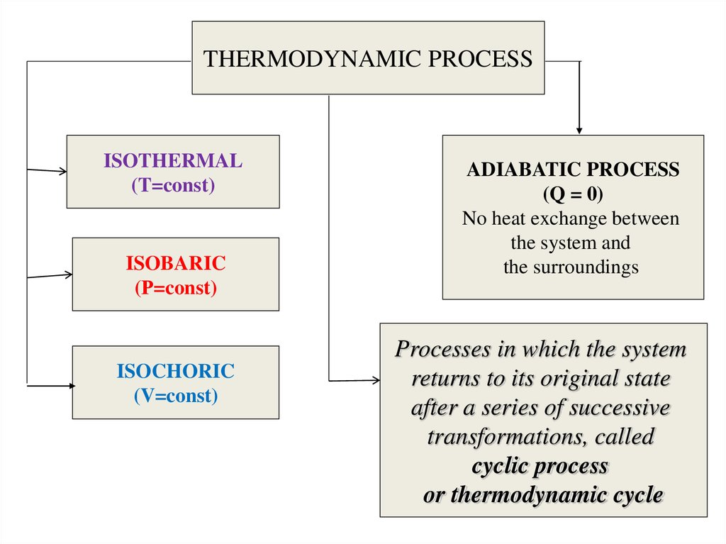

Slide 17
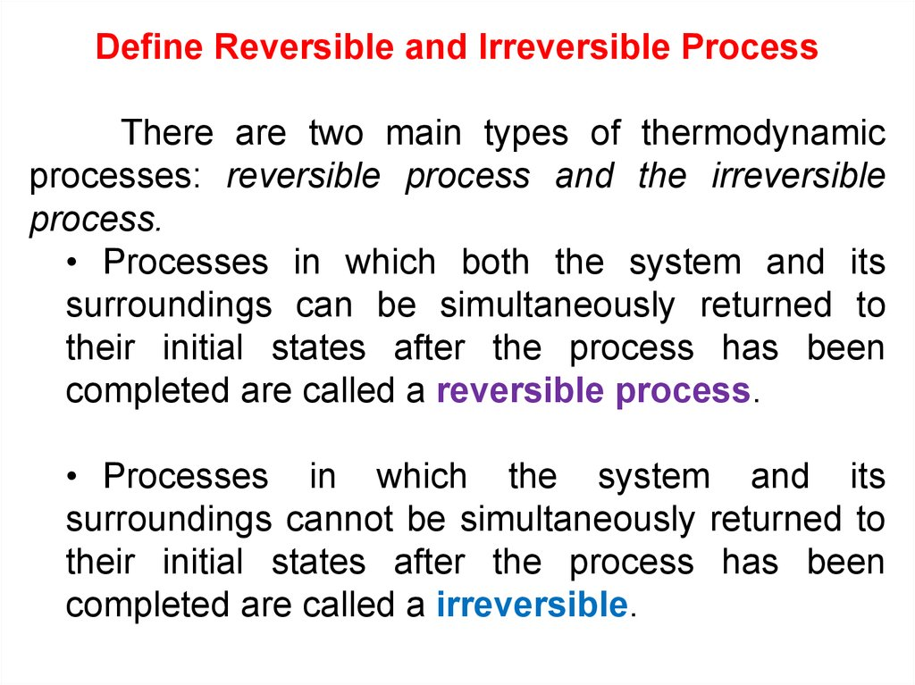

Slide 18
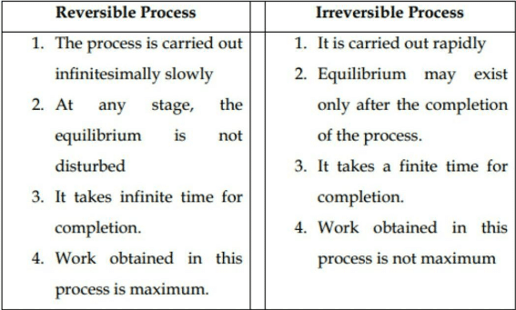
Difference between Reversible and Irreversible Processes

Slide 19
First Law of Thermodynamics

Slide 20
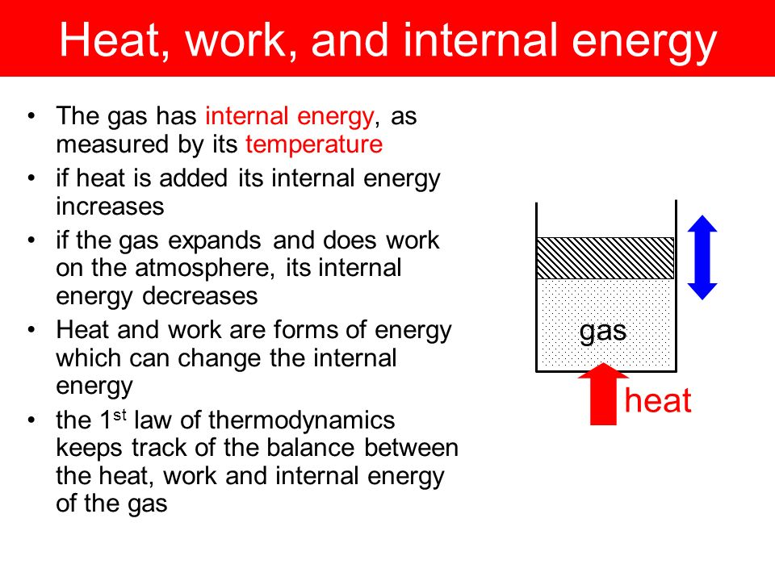

Slide 21
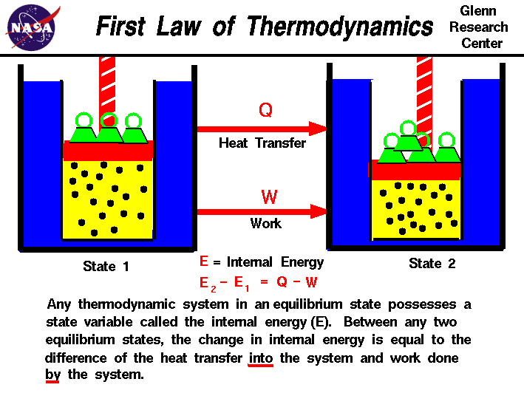

Slide 22
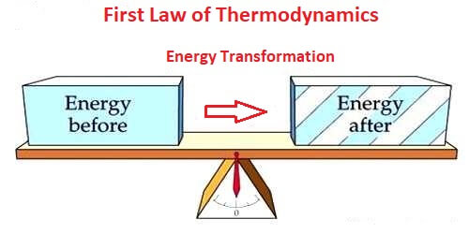

Slide 23
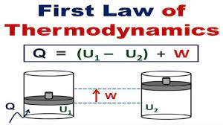
Mathematical expression of first law of thermodynamics

Slide 24
Concepts of Enthalpy

Slide 25
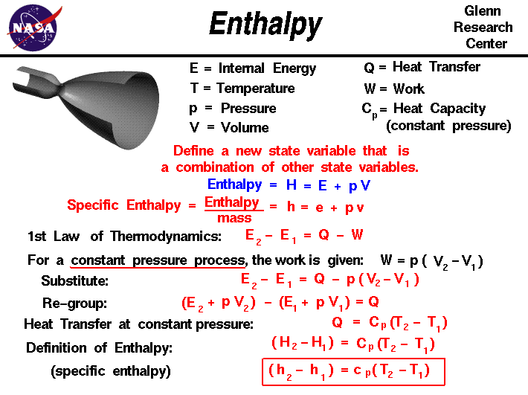

Slide 26
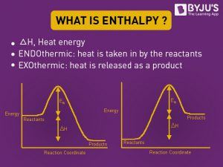
H

Slide 27
Next class’s objectives
Heat Capacity
2. Joule’s Experiment
3. Joule Thomson Experiment

Slide 28


